Slide 1

INHERITANCE
Focus on Program

Slide 2
Inheritance in Java is a mechanism in which one object acquires all the properties and behaviors of a parent object. It is an important part of OOPs (Object Oriented programming system).
The idea behind inheritance in Java is that you can create new classes that are built upon existing classes. When you inherit from an existing class, you can reuse methods and fields of the parent class. Moreover, you can add new methods and fields in your current class also.
Inheritance represents the IS-A relationship which is also known as a parent-child relationship.(meaning a child class (subclass) is a specialized form of a parent class (superclass))

Slide 3
Class: A class is a group of objects which have common properties. It is a template or blueprint from which objects are created.
Sub Class/Child Class: Subclass is a class which inherits the other class. It is also called a derived class, extended class, or child class.
Super Class/Parent Class: Superclass is the class from where a subclass inherits the features. It is also called a base class or a parent class.
Reusability: As the name specifies, reusability is a mechanism which facilitates you to reuse the fields and methods of the existing class when you create a new class. You can use the same fields and methods already defined in the previous class.

Slide 4
Syntax
class Subclass-name extends Superclass-name
{
//methods and fields
}
The meaning of "extends" is to increase the functionality.

Slide 5
// Superclass
class Employee {
String name;
double salary;
Employee(String name, double salary) {
this.name = name;
this.salary = salary;
}
void showDetails() {
System.out.println("Employee: " + name + ", Salary: $" + salary);
}
}
// Subclass - Manager "is a" Employee
class Manager extends Employee {
String department;
Manager(String name, double salary, String department) {
super(name, salary); // Calls the Employee constructor
this.department = department;
}
@Override
void showDetails() {
super.showDetails();
System.out.println("Department: " + department);
}
}
// Main class
public class Company {
public static void main(String[] args) {
Manager m = new Manager("Alice", 90000, "HR");
m.showDetails();
}
}

Slide 6
2 cases to be kept in mind:
If parent class has no-arg constructor: the child class does not need to pass parameters explicitly. The Java compiler implicitly calls super().
If Parent Class Has a Parameterized Constructor, the child class must explicitly call super (arguments)

Slide 7
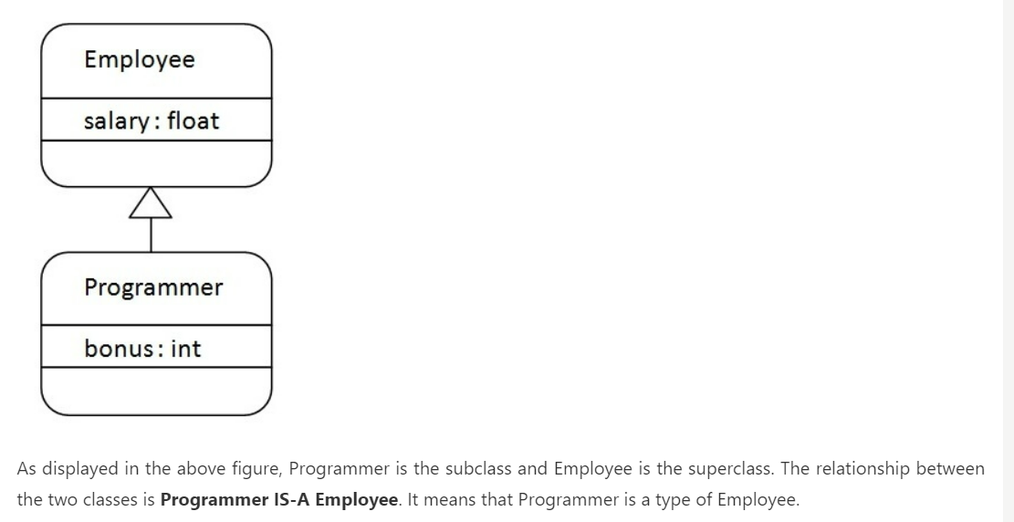

Slide 8
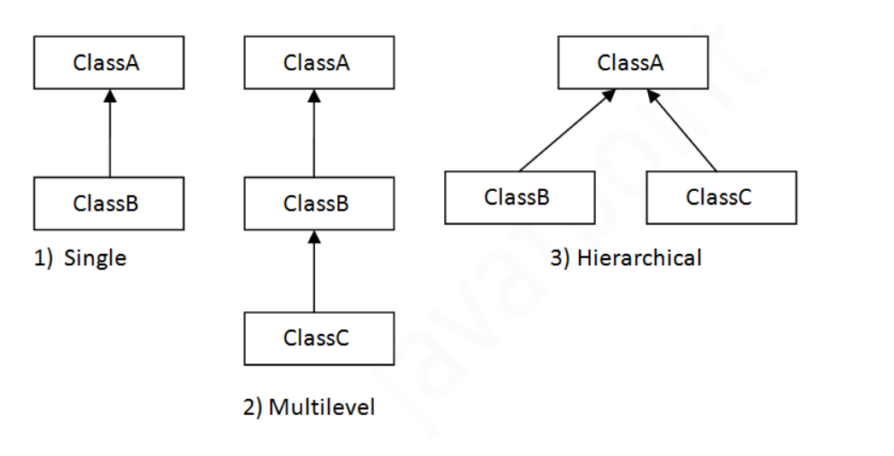
Types of Inheritance

Slide 9
Ques
Banking System can have a BankAccount class with attributes like accountHolder and balance, and child classes like SavingsAccount (with interestRate) and CurrentAccount (with overdraftLimit). The system should allow operations such as deposits, withdrawals, and interest calculation.
Implement a main class that creates objects of different subclasses and demonstrates polymorphic behavior through method overriding.

Slide 10
Order of constructor execution (inheritance)
In single level inheritance, the constructor of the base class is executed first
A child class constructor or method can access the base class constructor or method using the super keyword.
The super keyword refers to superclass (parent) objects.
It is used to call superclass methods, and to access the superclass constructor.
The most common use of the super keyword is to eliminate the confusion between superclasses and subclasses that have methods with the same name.

Slide 11
Uses of “super“ keyword
Accessing Parent Class Constructor
Accessing Parent Class Methods
Accessing Parent Class Variables
Rules of using “Super”
must be the first statement inside a constructor
cannot be used in static methods since it refers to an instance

Slide 12
POLYMORPHISM
Polymorphism in Java is a concept by which we can perform a single action in different ways.
There are two types of polymorphism in Java: compile-time polymorphism and runtime polymorphism. We can perform polymorphism in java by method overloading and method overriding.
If you overload a static method in Java, it is the example of compile time polymorphism

Slide 13
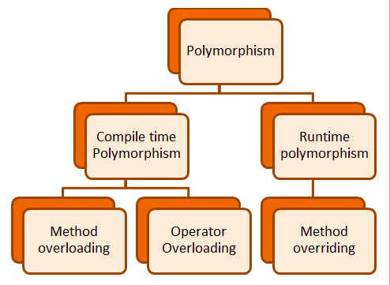

Slide 14
Compile time polymorphism- METHOD OVERLOADING
the Java compiler determines which version of the multiply method to call based on the method signature (method name and the parameter list).
This determination is made at compile time, hence the term compile-time polymorphism.
Each method call is linked to its respective method with matching parameters during the compilation, showcasing the polymorphic behavior at compile time

Slide 15
Abstraction is a process of hiding the complex implementation details and showing only the essential features of the object. It is mainly achieved in Java using abstract classes and interfaces. An abstract class can include abstract methods, which are method declarations without an implementation. Interfaces can define a contract for what a class can do, without specifying how it does it.
Polymorphism allows objects of different classes to be treated as objects of a common super class. The most common use of polymorphism in OOP occurs when a parent class reference is used to refer to a child class object. It enables a single action to behave differently based on the object that it is acting upon. There are two types of polymorphism in Java: compile-time (static) polymorphism and runtime (dynamic) polymorphism. Method overloading is an example of static polymorphism, while method overriding is an example of dynamic polymorphism

Slide 16
Runtime polymorphism or Dynamic Method Dispatch
METHOD OVERRIDING (INHERITANCE)

Slide 17
If subclass (child class) has the same method as declared in the parent class, it is known as method overriding in Java.
Method overriding is used to provide the specific implementation of a method which is already provided by its superclass.
Method overriding is used for runtime polymorphism.
In this process, an overridden method is called through the reference variable of a superclass. The determination of the method to be called is based on the object being referred to by the reference variable.
Rules for Method Overriding:
The method must have the same name as in the parent class
The method must have the same parameter as in the parent class.
There must be an IS-A relationship (inheritance).

Slide 18
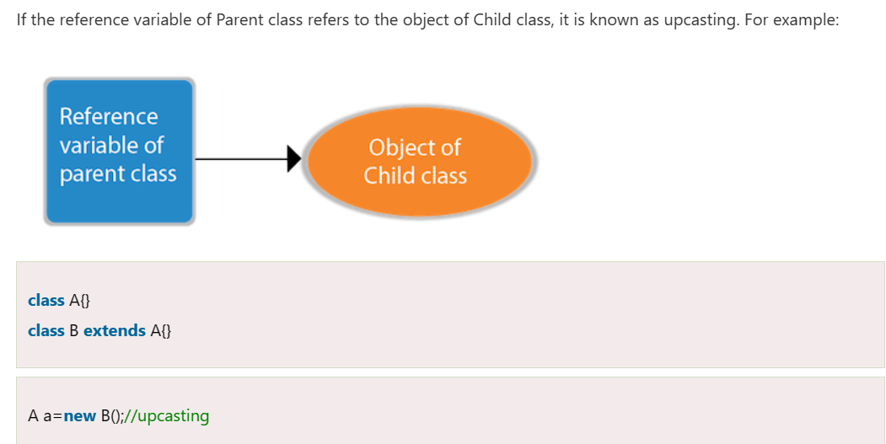
upcasting

Slide 19
Advantages of Polymorphism in Java
Increases code reusability by allowing objects of different classes to be treated as objects of a common class.
Improves readability and maintainability of code by reducing the amount of code that needs to be written and maintained.
Supports dynamic binding, enabling the correct method to be called at runtime, based on the actual class of the object.
Enables objects to be treated as a single type, making it easier to write generic code that can handle objects of different types.
Disadvantages of Polymorphism in Java
Can make it more difficult to understand the behavior of an object, especially if the code is complex.
This may lead to performance issues, as polymorphic behavior may require additional computations at runtime.

Slide 20
Run time polymorphism: dynamic method dispatch
// Parent class
class Payment {
void pay() {
System.out.println("Processing payment...");
}
}
// Subclass for credit card payment
class CreditCardPayment extends Payment {
@Override
void pay() {
System.out.println("Payment done using Credit Card");
}
}
// Subclass for PayPal payment
class PayPalPayment extends Payment {
@Override
void pay() {
System.out.println("Payment done using PayPal");
}
}
// Main class
public class PaymentSystem {
public static void main(String[] args) {
Payment payment;
payment = new CreditCardPayment();
payment.pay(); // Calls CreditCardPayment's pay() method
payment = new PayPalPayment();
payment.pay(); // Calls PayPalPayment's pay() method
}
}

Slide 21
ABSTRACTION
Abstraction is a process of hiding the implementation details and showing only functionality to the user

Slide 22
Abstract class in java
A class which is declared with the abstract keyword is known as an abstract class in .It can have abstract and non-abstract methods (method with the body).
There are two ways to achieve abstraction in java
Abstract class (0 to 100%)
Interface (100%)
A class which is declared as abstract is known as an abstract class. It can have abstract and non-abstract methods. It needs to be extended and its method implemented. It cannot be instantiated.
Syntax: abstract class Test{ }

Slide 23
Abstract method
A method which is declared as abstract and does not have implementation is known as an abstract method.
abstract void printStatus(); // no implementation.
If there is an abstract method in a class, that class must be abstract.

Slide 24
Imp Points abstract class!
Can have constructor
Can have main method also
can exist without abstract methods.
can implement an interface
abstract class cannot be final

Slide 25
Cont.
Abstract method CANNOT BE static.
an abstract method cannot be private because it must be overridden in subclasses, and private methods cannot be inherited.
If a subclass does not implement all abstract methods of an abstract class, it must also be declared abstract.

Slide 26
Final variable: variable cannot be reassigned once it is initialized (Very Impotant)
class Test {
final int MAX_VALUE = 100;
void display() {
// MAX_VALUE = 200; ❌ Compilation Error (cannot be changed)
System.out.println("Final Variable: " + MAX_VALUE);
}
}
public class Main {
public static void main(String[] args) {
Test obj = new Test();
obj.display();
}
}

Slide 27
Final Method-cannot be overridden by subclasses.
class Parent {
final void show()
{
System.out.println("Final method in
Parent class");
}
}
class Child extends Parent {
// void show()
{ ❌ Compilation Error (Cannot override final method)
// System.out.println("Trying to override final method");
// }
}
public class Main {
public static void main(String[] args) {
Child obj = new Child();
obj.show(); // Calls the final method from Parent
}
}

Slide 28
Final Class- Cannot be inherited

Slide 29
abstract class can have final methods, but final methods cannot be abstract.
Java does not allow a final constructor because constructors cannot be inherited or overridden.

Slide 30
Abstract class Payment
abstract class Payment {
protected double amount;
public Payment(double amount) {
this.amount = amount;
}
// Abstract method - must be implemented by subclasses
abstract void processPayment();
// Concrete method - common for all payments
public void printReceipt() {
System.out.println("Receipt: Payment of $" + amount + " processed.");
}
}

Slide 31
Child classes
// Credit Card Payment Implementation
class CreditCardPayment extends Payment {
private String cardNumber;
public CreditCardPayment(double amount, String cardNumber) {
super(amount);
this.cardNumber = cardNumber;
}
@Override
void processPayment() {
System.out.println("Processing credit card payment of
$" + amount + " using card: " + cardNumber);
printReceipt();
}
}
// PayPal Payment Implementation
class PayPalPayment extends Payment {
private String email;
public PayPalPayment(double amount, String email) {
super(amount);
this.email = email;
}
@Override
void processPayment() {
System.out.println("Processing PayPal payment of $" + amount + " using email: " + email);
printReceipt();
}
}

Slide 32
Payment System
public class PaymentProcessor {
public static void main(String[] args) {
// Process Credit Card Payment
Payment creditCardPayment = new CreditCardPayment(100.50, "1234-5678-9876-5432");
creditCardPayment.processPayment();
System.out.println("----------------------------");
// Process PayPal Payment
Payment payPalPayment = new PayPalPayment(75.25, "user@example.com");
payPalPayment.processPayment();
}
}

Slide 33
IMPORTANT POINTS

Slide 34
Method hiding using static methods
class Parent {
static void display() { System.out.println("Parent"); }
}
class Child extends Parent {
static void display() { System.out.println("Child"); }
}
public class Main {
public static void main(String[] args) {
Parent obj = new Child();
obj.display(); // Parent
}
}

Slide 35
Static Methods Are Not Overridden:
In Java, static methods belong to the class and not to instances of the class.
When a static method is redefined in a subclass using the same signature, it is called method hiding, not method overriding.

Slide 36
In method overriding (with non-static methods), the method that gets executed is determined by runtime polymorphism (based on the actual object type).
In method hiding (with static methods), the method that gets executed is determined by reference type, not the object type.

